Slide 1
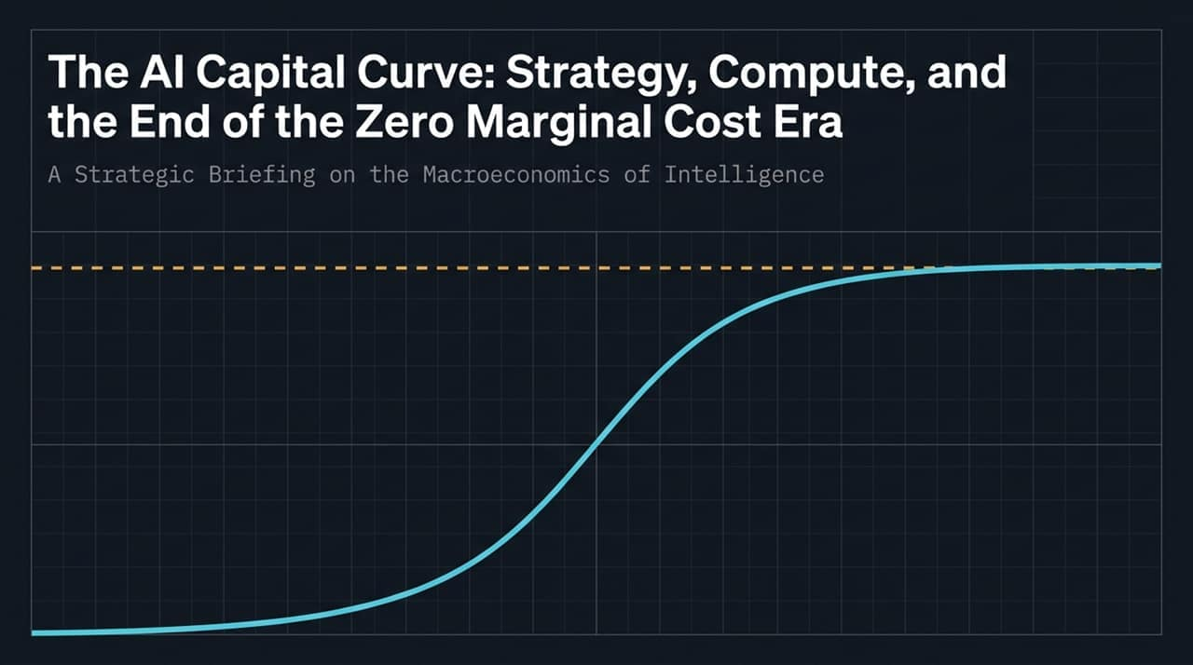
Notes:
Good morning, everyone. Let’s open today’s briefing by stepping back and looking at the macro game board—specifically how geopolitical realities and market dynamics dictate the trajectory of global AI.
If you look at the graphic on this slide, you’ll see two balanced forces linked by a single bottleneck. On the left, we have US Frontier Dominance—led by players like OpenAI and Anthropic—relentlessly pushing the boundary of core intelligence. On the right, we have Chinese rapid distillation. Right now, Chinese labs are running 6 to 9 months behind US models. They aren't paying the full multidollar price tag of initial frontier training; instead, they are using distillation techniques to extract maximum intelligence out of existing models at a fraction of the cost.
Sitting right between these two forces is TSMC—the world's ultimate supply-chain chokepoint.
Now, why is this dynamic so stable, and why is it dangerous if disturbed? Let's walk through three key strategic realities:
First, The Current Status Quo. Today, we exist in a functional game-theory equilibrium. The US maintains a comfortable lead in frontier capabilities, while China stays competitive enough through distillation. Because both sides rely heavily on the same high-end semiconductor manufacturing at TSMC, neither side has an incentive to disrupt the balance.
Second, The Fantastical Danger. If the US tries to push for absolute, crushing technological or military AI dominance—attempting to choke off adversary access entirely—we alter the pay-off matrix. In game theory, if an adversary realizes they are permanently locked out of the future economy, the rational, game-theory-optimal response shifts from economic competition to existential disruption. In a desperate scenario, taking out or neutralizing the TSMC chokepoint becomes a viable strategic option for them. A runaway US lead actually increases military risk around Taiwan.
Finally, The Delusion of Decoupling. Everyone talks about nearshoring or building redundant fabs in Europe and North America. But the capital expenditure required to replicate TSMC’s ecosystem outside of Taiwan and China is astronomically high. Supply-chain diversification is an insurance policy that tech giants and governments will refuse to pay at full scale unless literally forced by active military conflict.
As long as this 6-to-9-month distillation lag holds, the system remains in a tense, stable equilibrium. Keep this geopolitical backdrop in mind, because it directly dictates how capital flows into hardware, which brings us to Slide 2.
https://www.youtube.com/watch?v=h-0NZ-oIjlk

Slide 2
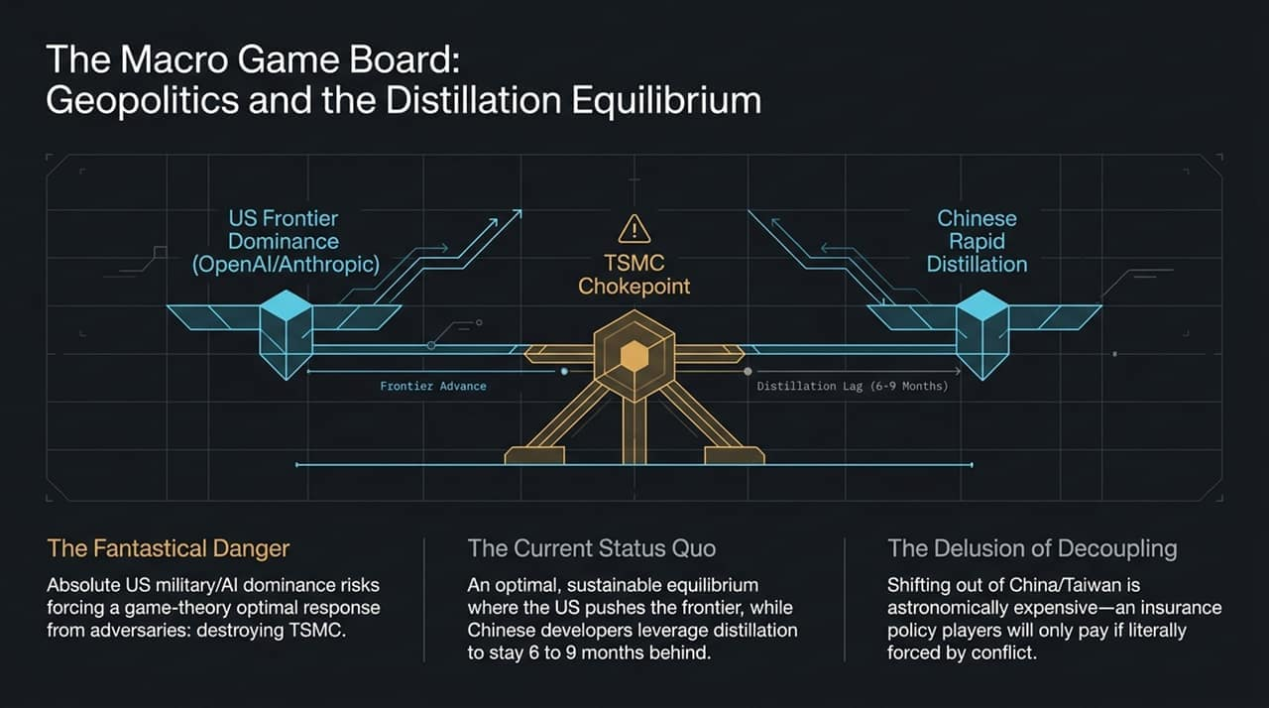
Notes:
Moving to Slide 2, let's examine the financial plumbing powering this expansion. To understand where AI capital is moving, we have to look back at economic history—specifically the Great Railroad Buildout of the 1870s.
Take a look at the chart on this slide. The light blue line represents Capital Investment (CapEx), spiking massively in the early years and staying high. The white line at the bottom represents Revenue Realization, which grows gradually over a ten-year arc. The dark shaded area between those two lines is what we call The Air Gap—or the financial blowup risk.
There are three core takeaways from this capital curve:
First, The Duration Mismatch. Building out global AI infrastructure—data centers, power grids, and custom silicon—is a multi-decade capital endeavor. However, it is being funded primarily by short-term financial instruments and corporate earnings cycles. Just like the 1870s railroads, where thousands of miles of track were laid before transcontinental freight demand matured, we are building infrastructure years ahead of true market monetisation.
Second, The Capital Curve Shift. Over the past two years, the industry burned through free cash flow. Then, debt markets were rapidly tapped and exhausted within roughly twelve months. Now, to bridge this massive Air Gap, major entities are resorting to issuing equity, taking on specialized project debt, and even tapping massive institutional capital like pension funds. Annual AI-related capital expenditures are climbing rapidly from $800 billion toward $1.3 trillion.
Third, The Legacy Infrastructure. Here is the ultimate silver lining: Even if the financial bubble bursts inside this Air Gap—even if rail companies went bankrupt in the 1870s—the steel tracks stayed in the ground. When the dot-com bubble burst, the thousands of miles of dark fiber laid by WorldCom remained.
Whatever happens to individual company valuations or financial structures, the compute clusters, power grid upgrades, and physical data centers being funded today will remain. They will permanently lower the cost of compute and boost global productivity for decades to come.
Now, let’s dive into how individual Big Tech companies are positioning their balance sheets to survive this exact Air Gap...

Slide 3
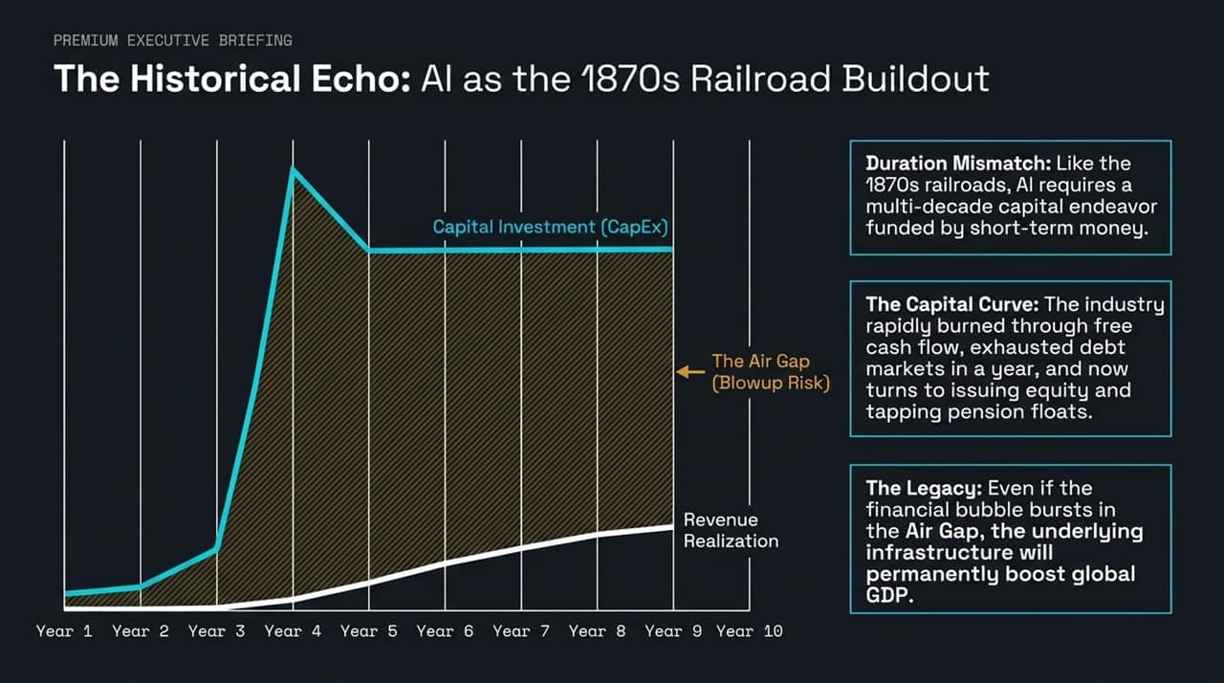
Notes:
To understand where AI capital is heading, we need to look back at the 1870s railroad boom. Railroads required multi-decade, front-loaded capital investments, yet they were largely funded by short-term financial instruments. This duration mismatch created what we call The Air Gap—the multi-year period where CapEx spikes dramatically long before enterprise revenue realization catches up.
The AI sector has burned through free cash flows and exhausted traditional debt markets in record time, now turning to equity issuance and tapping deep capital pools. The critical takeaway here is risk management: even if a financial bubble forms and bursts within this Air Gap, the underlying physical infrastructure—the data centers, fibers, and power grids—remains intact, permanently lifting baseline global productivity and GDP.

Slide 4
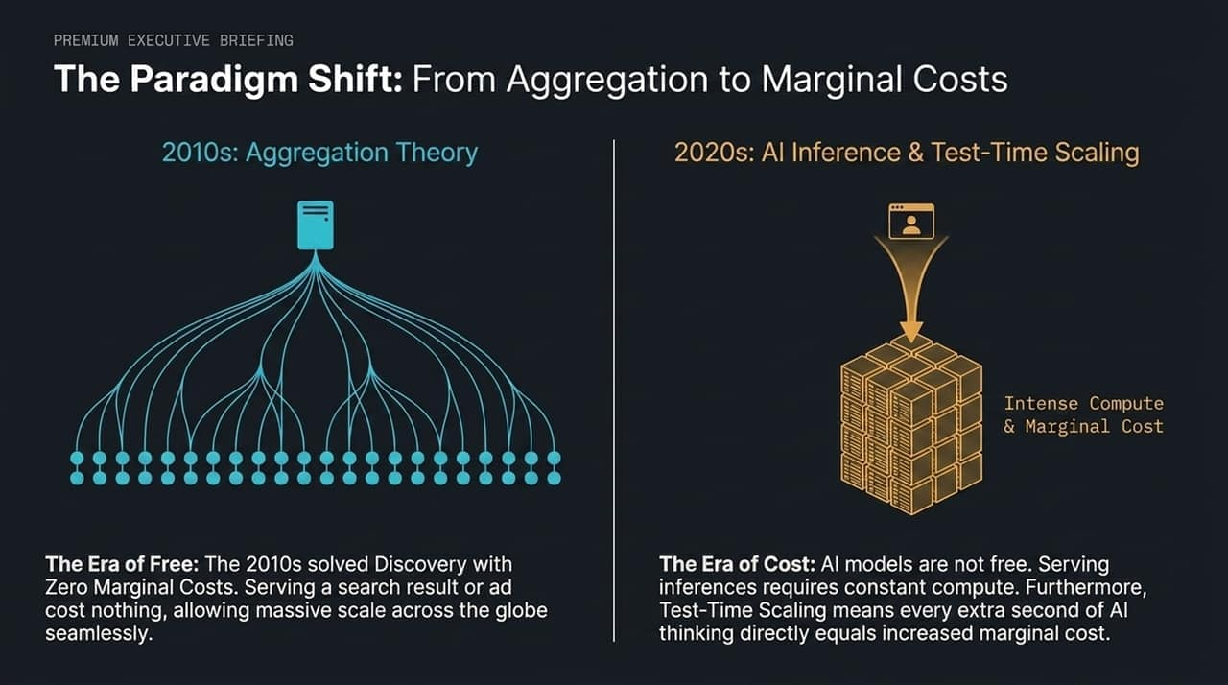
Notes:
Let's contrast the 2010s with the 2020s. In the 2010s, Ben Thompson’s Aggregation Theory ruled. Serving an extra search result or ad cost essentially zero dollars, allowing platform scale with sky-high operating margins.
In the 2020s, AI inference and test-time scaling destroy zero marginal cost. Serving model outputs requires active, continuous compute. With architectures moving toward test-time reasoning—where a model spends additional seconds thinking through a problem before answering—every single compute step directly incurs incremental marginal cost. AI is an era of unit-cost discipline, not free distribution.

Slide 5
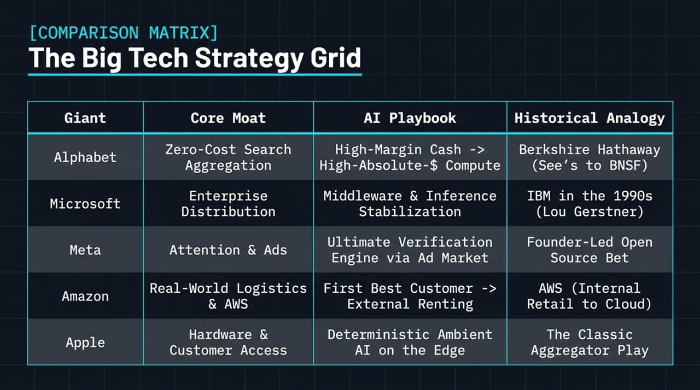
Notes:
Because marginal costs are high, no single playbook works for every tech giant. Looking at this matrix, each firm is leveraging its legacy core moat to survive the AI shift:
Alphabet uses its zero-cost search cash engine to fund massive absolute-dollar compute.
Microsoft operates as a middleware stabilizer, positioning itself like 1990s IBM.
Meta relies on open-source model distribution backed by its liquid ad market verification engine.
Amazon acts as its own first best customer to commercialize custom silicon.
Apple leverages edge control to push compute costs to user devices.
Let's drill down into each of these strategies.

Slide 6
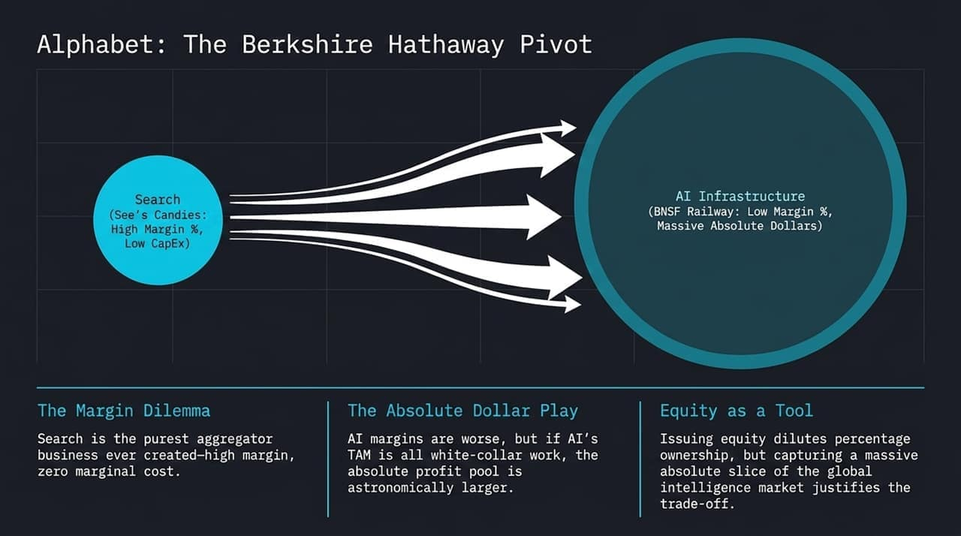
Notes:
Alphabet is undergoing a structural pivot akin to Berkshire Hathaway shifting capital from high-margin See’s Candies into capital-intensive BNSF Railway. Google Search remains the purest aggregator ever built—generating massive cash with zero marginal cost. However, Google is consciously reinvesting those margins into low-margin, high-absolute-dollar AI infrastructure.
Why accept lower percentage margins? Because the addressable market for automated white-collar work and global intelligence is order-of-magnitude larger than search advertising. Capturing a dominant percentage slice of a multi-trillion-dollar intelligence market justifies diluting operating margins.

Slide 7
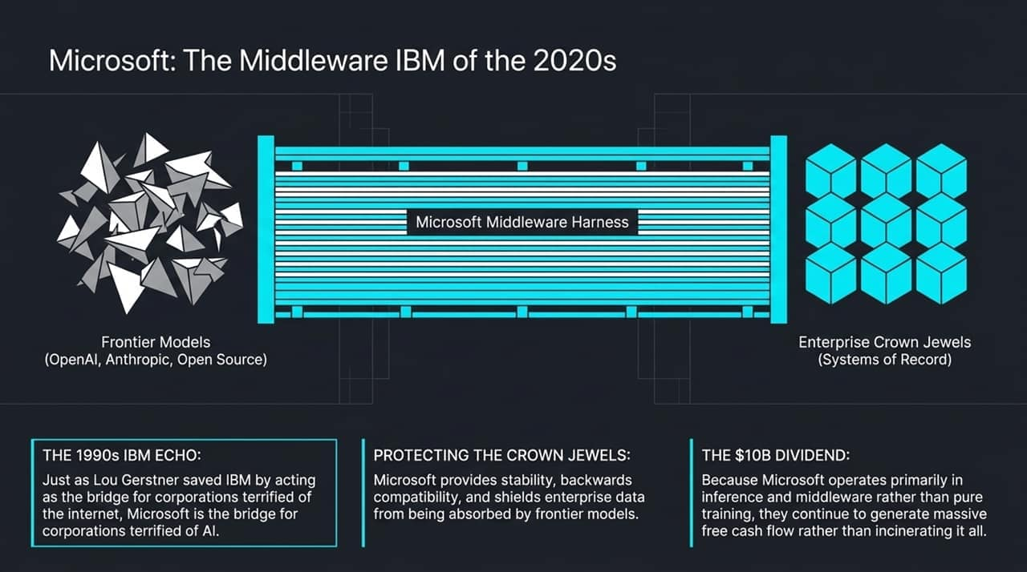
Notes:
Microsoft’s strategy is modeled after Lou Gerstner’s turnaround of IBM in the 1990s. When enterprise clients were terrified of the open internet, IBM acted as the secure integration layer. Today, enterprise CFOs and CISOs are terrified of data leakage and non-deterministic model outputs.
Microsoft sits between frontier models—OpenAI, Anthropic, or open source—and the corporate systems of record. By selling backwards compatibility, governance, and middleware stability, Microsoft captures the AI enterprise tax while preserving its cash flow, avoiding the full burden of training expense.

Slide 8
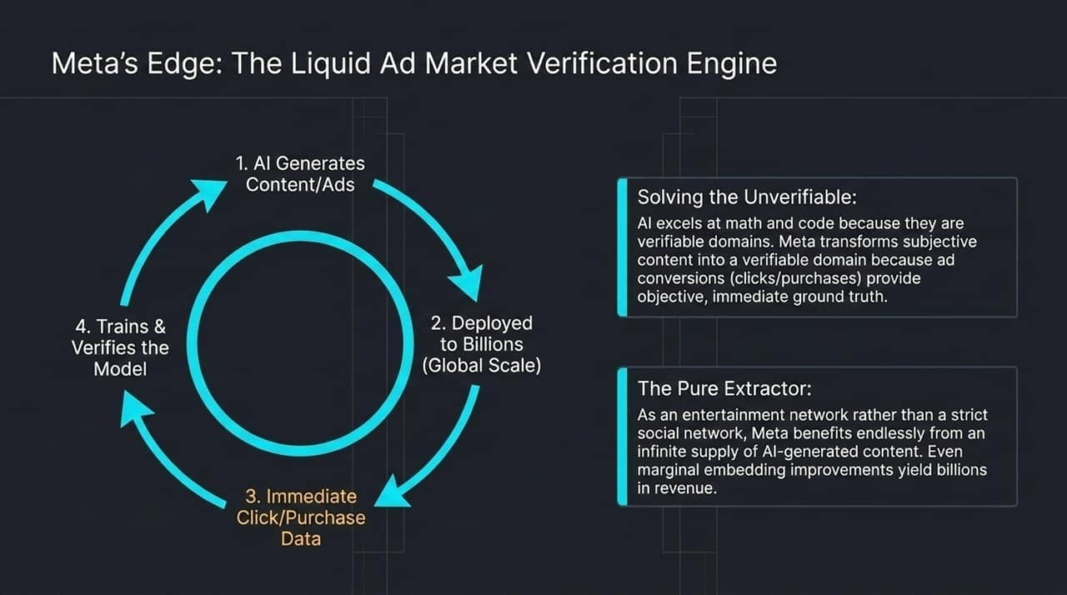
Notes:
Frontier models naturally excel at verifiable domains like code and mathematics because correct answers are objective. They struggle with subjective domains like creative writing or social content. Meta solves this by transforming subjective content creation into a verifiably objective domain via its real-time ad market.
When Meta’s AI generates ad creative or content, it deploys it instantly to billions of users. Immediate clicks and conversions provide instant ground-truth data, creating a continuous reinforcement learning loop. Moreover, as an entertainment distribution network, every minor percentage point increase in user engagement directly translates to billions in ad revenue.

Slide 9
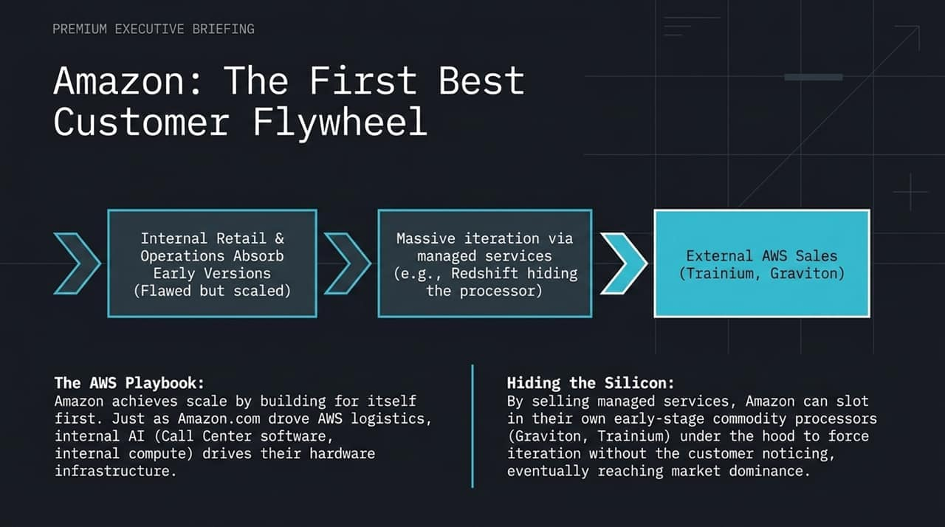
Notes:
Amazon’s playbook relies on the exact mechanism that built AWS: being its own first best customer. Amazon absorbs early, unrefined iterations of its custom hardware—like Trainium and Graviton—across its internal retail, logistics, and customer service operations.
Once these chips reach performance parity at scale, Amazon packages them under managed services like Redshift or SageMaker. Customers buy higher-level managed software, while Amazon swaps out costly third-party GPUs for cheap internal silicon underneath without disturbing end-user performance, systematically driving down their capital costs.

Slide 10
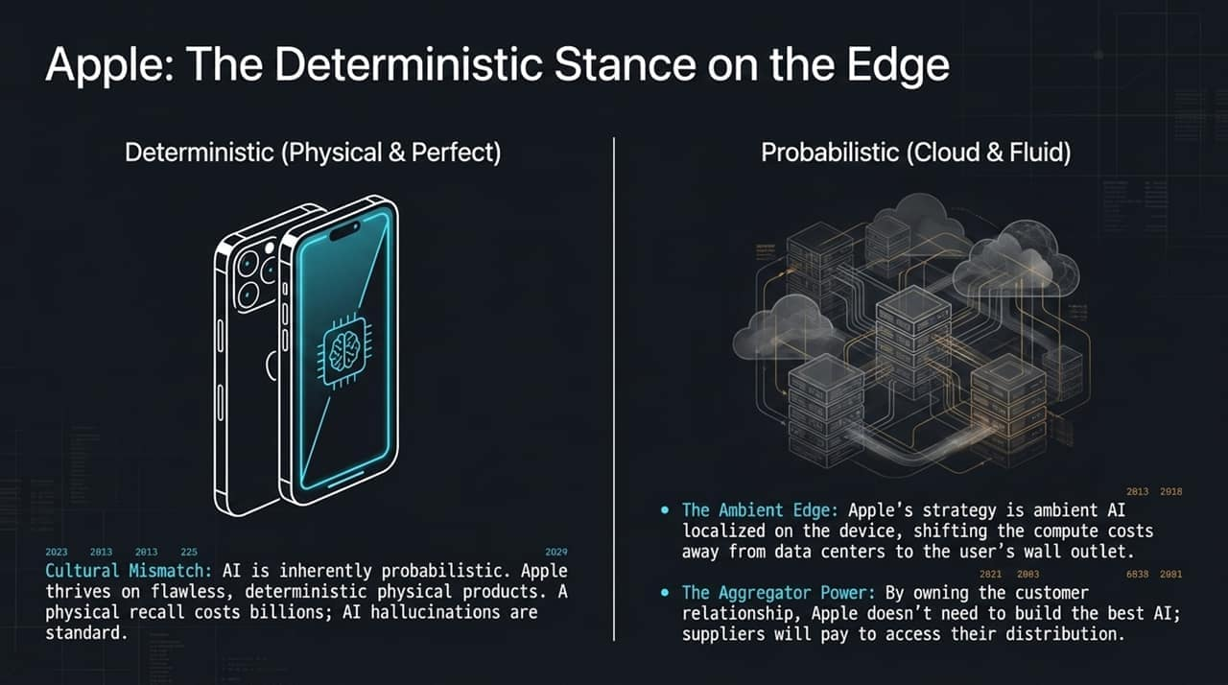
Notes:
Apple faces a fundamental cultural mismatch with AI. Apple’s brand relies on perfection and deterministic physical products; a hardware defect causes costly recalls, whereas AI models are non-deterministic and prone to hallucinations.
Apple’s solution is two-fold. First, Ambient AI on the Edge: running smaller localized models directly on iPhone neural engines. This offloads the massive power and compute burden from cloud data centers directly to the consumer's wall outlet. Second, as the ultimate distribution aggregator, Apple lets cloud AI providers battle for integration inside iOS, forcing partners to pay for access to Apple’s user base.

Slide 11
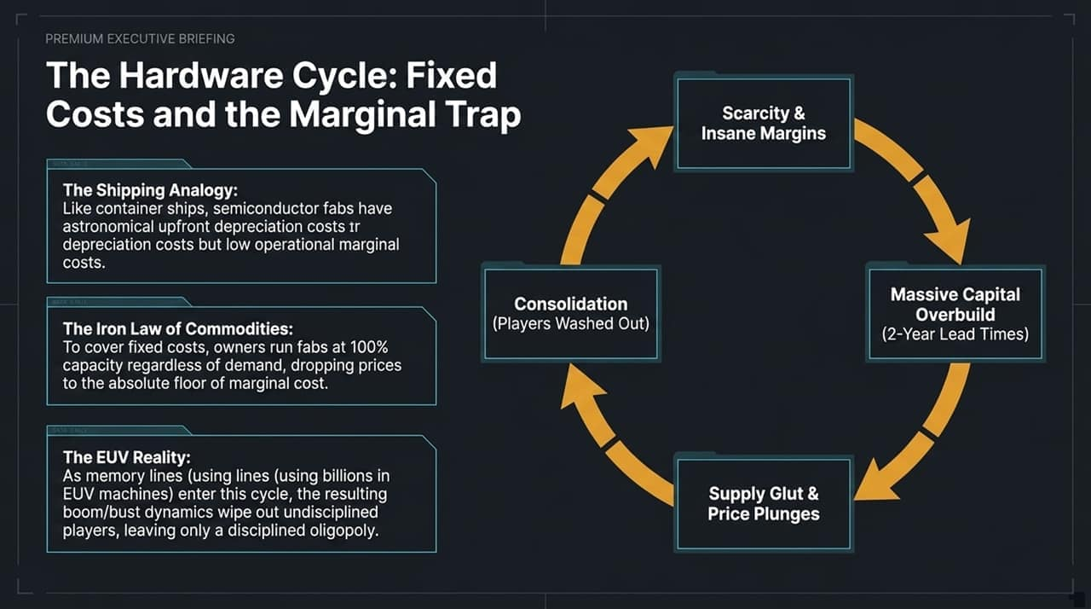
Notes:
Now let’s look at the underlying hardware economics. Semiconductor fabs operate under the same economic rules as global container shipping: astronomical upfront fixed CapEx and low operating marginal costs.
This creates the Iron Law of Commodities: to cover massive depreciation expenses, fab owners run facilities at 100% capacity regardless of near-term demand fluctuations, which periodically collapses spot pricing down to marginal costs. As memory and logic lines demand multi-billion-dollar Extreme Ultraviolet (EUV) lithography machines, these boom-and-bust capital cycles consolidate the industry, wiping out fragile players and leaving a highly disciplined oligopoly.

Slide 12
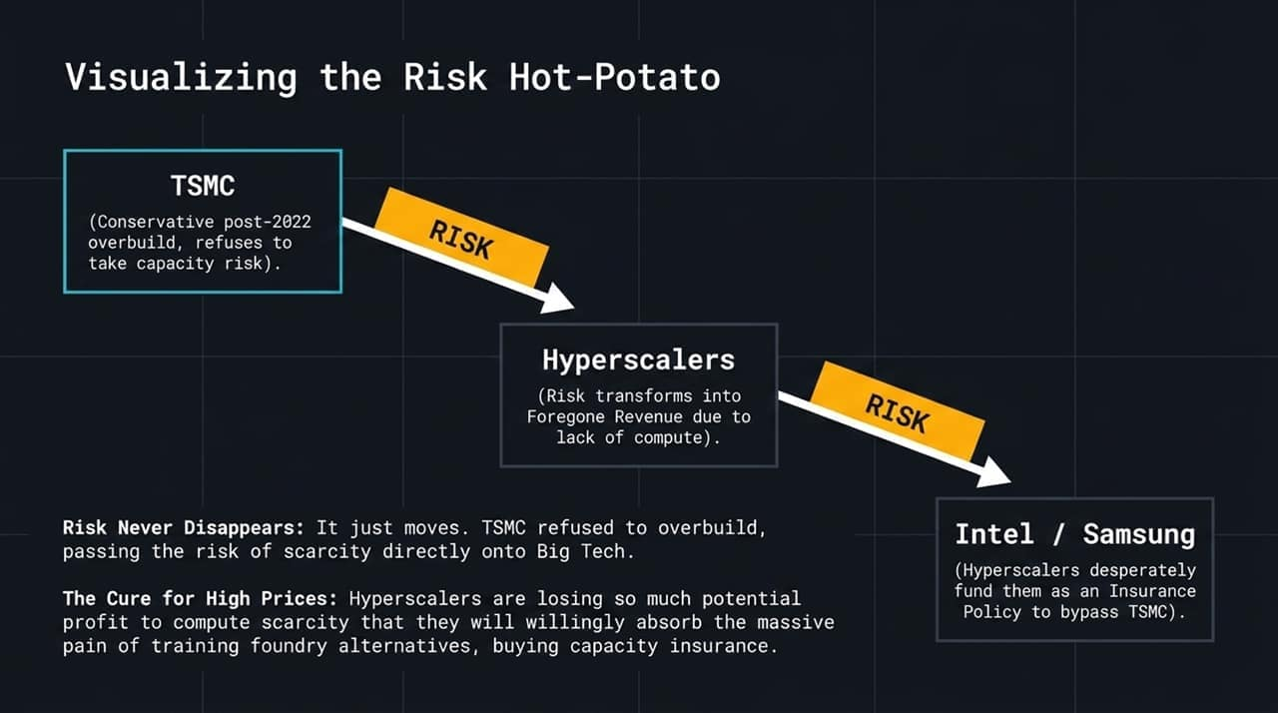
Notes:
Because semiconductor capacity is so capital-intensive, risk doesn't disappear—it gets passed around like a hot potato. After the 2022 tech slowdown, TSMC took a conservative stance and refused to absorb overbuild risk.
This passed the risk straight to Hyperscalers in the form of foregone revenue due to compute shortages. To hedge against TSMC’s choke point, Hyperscalers are actively funding secondary options—injecting capital into Intel and Samsung foundries as an insurance policy. They are willing to pay a premium for alternative foundry capacity to ensure guaranteed access to future silicon.

Slide 13
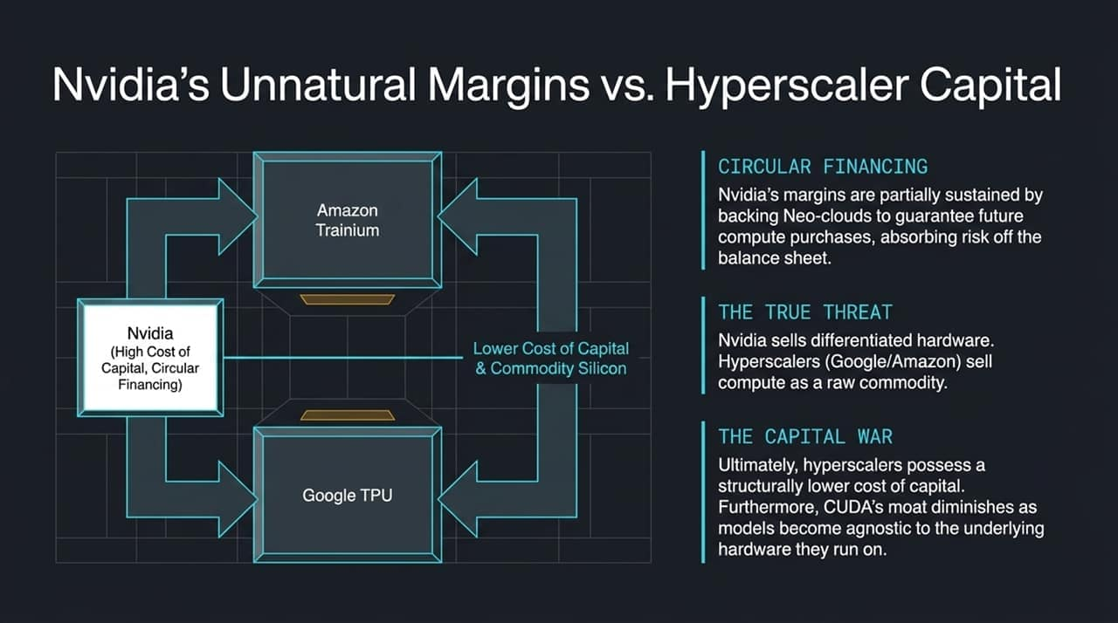
Notes:
Nvidia currently enjoys historically high gross margins, but it faces a structural headwind from its biggest clients. To sustain demand, Nvidia has engaged in circular financing dynamics—investing in specialized neo-clouds that commit to buying Nvidia GPUs.
However, the ultimate power lies with Google (TPU) and Amazon (Trainium). Hyperscalers possess a lower cost of capital and treat compute as a raw commodity, whereas Nvidia sells highly priced hardware. As software stacks become hardware-agnostic and CUDA’s software lock-in weakens, workloads naturally migrate toward cheaper, custom in-house silicon.

Slide 14
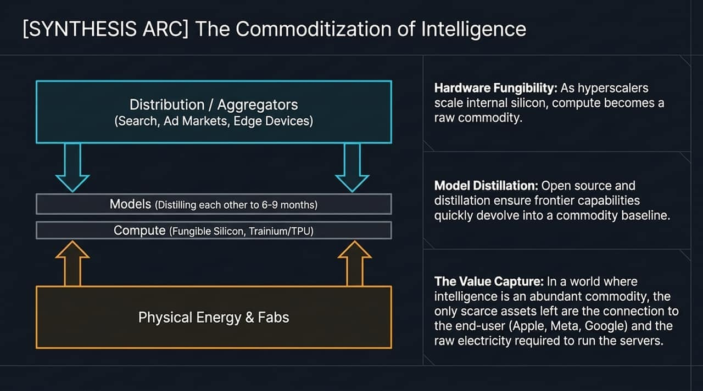
Notes:
Synthesizing these strategic arcs reveals a clear trend toward commoditization:
Hardware Fungibility: Custom internal chips turn compute into a utility baseline.
Model Distillation: Open-source models and distillation techniques allow secondary models to achieve 95% of frontier performance within 6 to 9 months, eroding model-layer moats.
The Value Capture: As intelligence becomes ubiquitous and cheap, value concentrates strictly at the structural extremes—distribution aggregators with direct end-user relationships at the top, and physical power and fabs at the bottom.

Slide 15
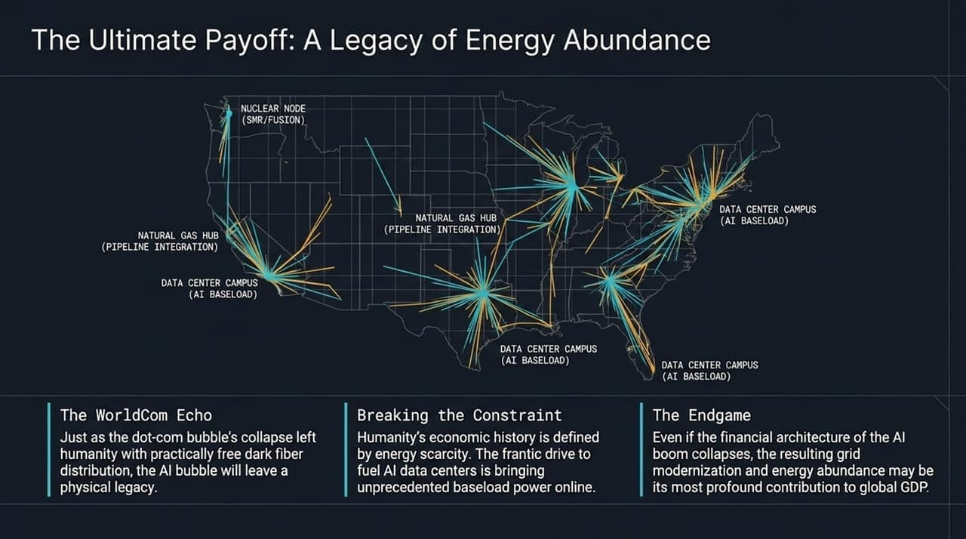
Notes:
Where does all this capital accumulation lead? Look at this map of projected data center campuses, natural gas hubs, and nuclear nodes. The primary constraint on AI scale is no longer chip production—it is electrical power grid capacity.
Just as the late-1990s telecom crash left behind a global network of dark fiber that enabled the modern internet, the AI CapEx race is forcing an unprecedented buildout of baseload power. Tech giants are directly funding nuclear restarts, Small Modular Reactors (SMRs), and pipeline integrations to secure terawatts of electricity.

Slide 16
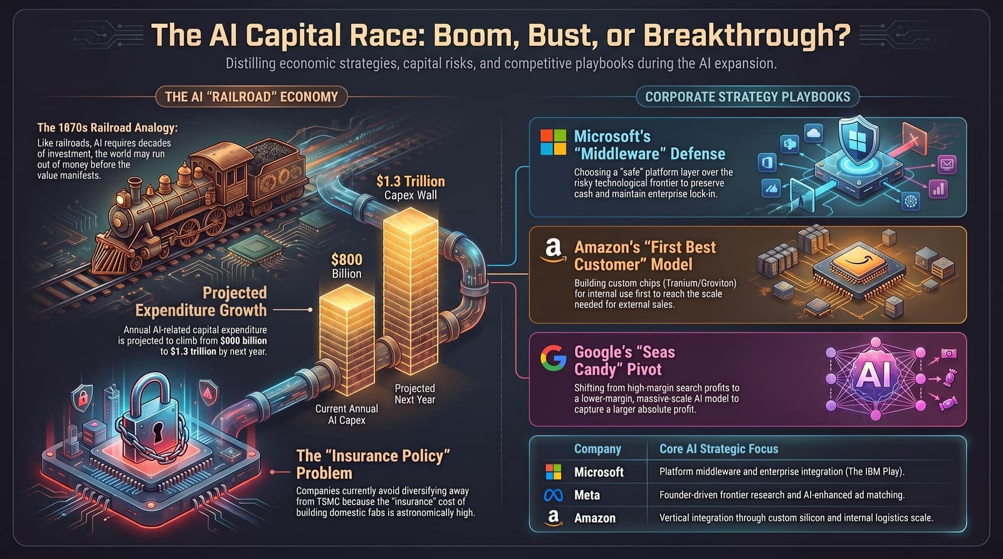
Notes:
To summarize our strategic briefing, this overview slide maps the core dynamics across the ecosystem:
Macro Dynamics: The $1.3 trillion CapEx wall faces the historical duration mismatch, while the TSMC single-point risk forces massive domestic foundry subsidies.
Playbook Execution: Microsoft secures the enterprise platform layer, Amazon leverages its internal retail scale for silicon iteration, and Google trades high search margins for raw compute volume.
Strategic Takeaway: Winning in the AI era requires managing unit economics, securing power baseloads, and owning end-user distribution.
In conclusion, we are navigating a fundamental transition from software's zero-marginal-cost era into an energy- and capital-constrained industrial buildout. While short-term market corrections may occur in the Air Gap between CapEx spending and enterprise software revenue, the macroeconomic outcome is clear: the massive infrastructure being built today will modernize global power grids and deliver low-cost intelligence, permanently boosting long-term economic productivity.
Thank you, and I am now open to taking your questions.

